Slide 1

Module 4 - Inheritance

Slide 2
Inheritance
Inheritance in Java is a mechanism where one class inherits methods and attributes from another class.
It ensures Code Reusability.

Slide 3
Inheritance
Class: A class is a group of objects which have common properties.
Sub Class/Child Class: Subclass is a class which inherits the other class. It is also called a derived class or extended class.
Super Class/Parent Class: Superclass is the class from where a subclass inherits the features. It is also called a base class or a parent class.

Slide 4
Syntax for Inheritance
To inherit a class, you simply incorporate the definition of one class into another by using the extends keyword
class Subclass-name extends Superclass-name
{
//methods and fields
}

Slide 5
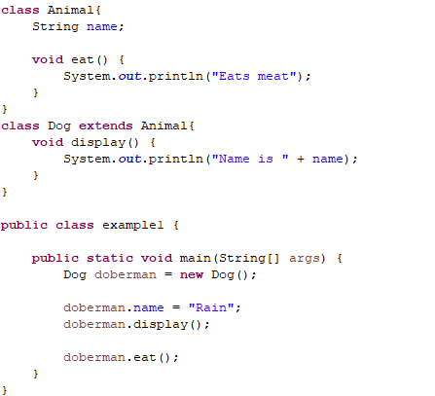

Example 1
OUTPUT

Slide 6
Member Access and Inheritance
Although a subclass includes all of the members of its superclass, it cannot access those members of the superclass that have been declared as private.

Slide 7
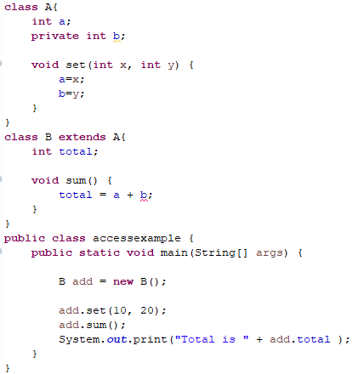
Example

Slide 8
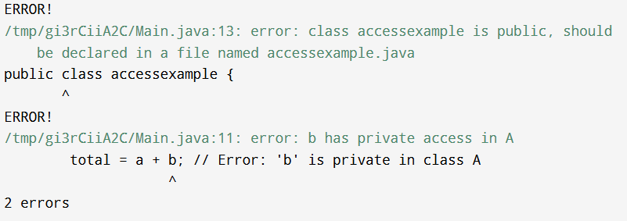

Slide 9
Types of inheritance
There can be three types of inheritance in Java:
single,
multilevel
hierarchical.

Slide 10
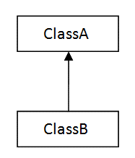

Single

Slide 11


Multilevel

Slide 12

Hierarchical

Slide 13
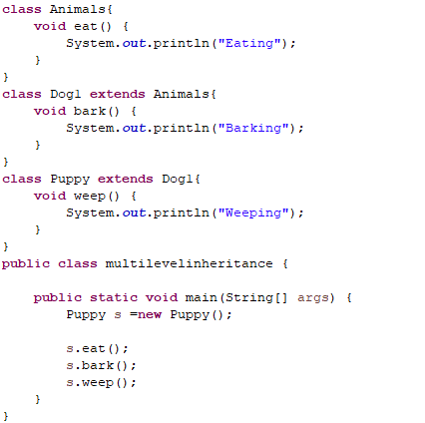
Example of Multilevel Inheritance

Slide 14
Use of super Keyword
The super keyword in Java is used in subclasses to refer to the parent class.
Usage of super:-
To call the superclass constructor
To access the superclass methods
To access superclass variables

Slide 15
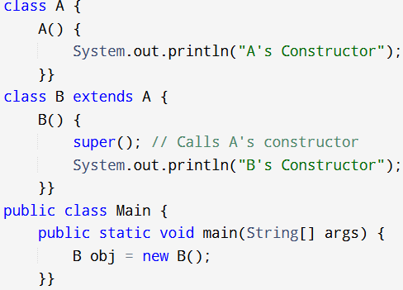

Using super for Constructor
OUTPUT

Slide 16
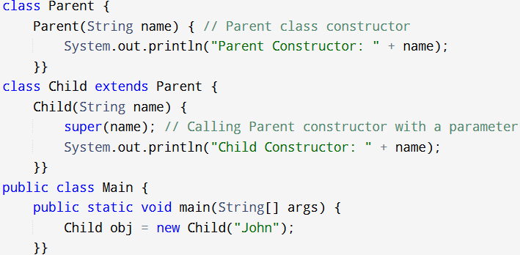
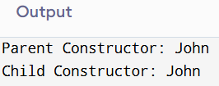

Slide 17
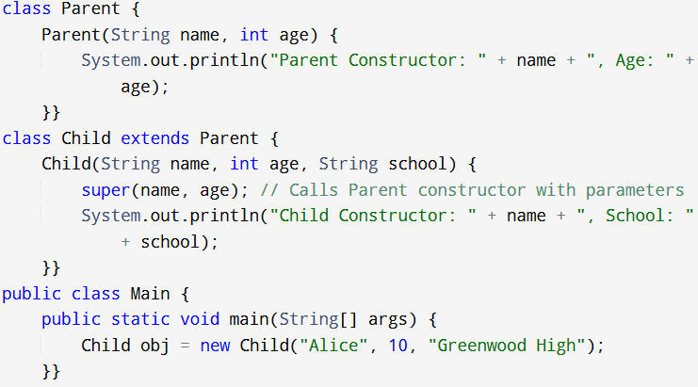


Slide 18
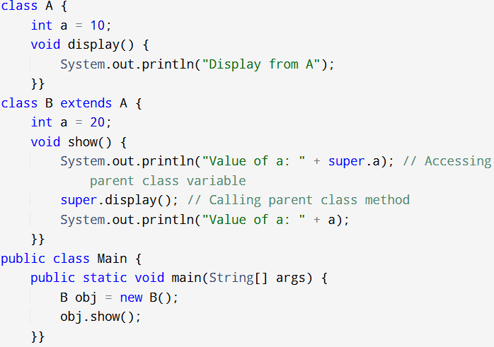
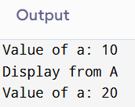
Using super for Methods and Variables

Slide 19
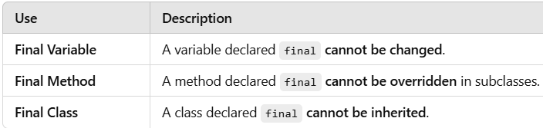
final Keyword in Java
The final keyword is used to restrict modification in Java.

Slide 20
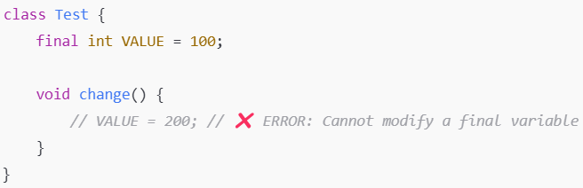

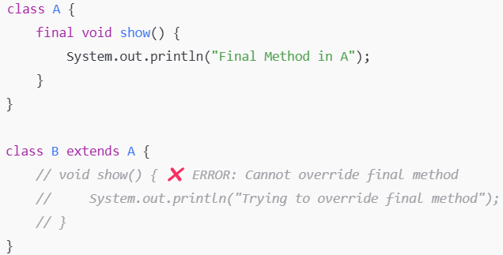

Slide 21
Try this out
Create a superclass called “Parent” with a method that prints “This is Parent class” and a subclass called “Child” having a method which prints “This is Child class”.

Slide 22
2.
Create a class named 'Member' having the following data: Name, Age and Salary. It also has a method named ‘printSalary’, which prints the salary of the members.
Two classes, 'Employee' and 'Manager' inherits the 'Member' class. The 'Employee' and 'Manager’ classes have data members 'specialization' and 'department’, respectively.
Now, assign the name, age and salary to an employee and a manager by making an object of both of these classes and print the salary for them.

Slide 23
3.
Create a class named 'Shape' with a method to print "This is This is shape". Then create two other classes named 'Rectangle', 'Circle' inheriting the Shape class, both having a method to print "This is rectangular shape" and "This is circular shape" respectively.
Create a subclass 'Square' of 'Rectangle' having a method to print "Square is a rectangle". Now call the method of 'Shape' and 'Rectangle' class by the object of 'Square' class.

Slide 24
4.
Imagine you are building software for a bank. The bank offers several types of accounts, such as Savings Accounts, Current Accounts, and Fixed Deposit Accounts. Each account type has some common features such as account number, account holder name, and balance, but they also have unique features such as interest rate for Savings Account, overdraft limit for Current Account, and maturity date for Fixed Deposit Account.
Using inheritance in Java, how would you design the classes for these account types to ensure that the common features are inherited from a base class, while also allowing for the unique features of each account type to be defined in its respective subclass? How would you ensure that the correct account type is identified when performing transactions or generating reports, based on the account holder's choice?

Slide 25
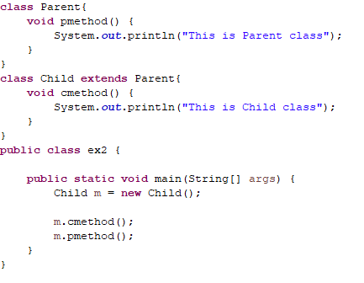
Solution 1

Slide 26
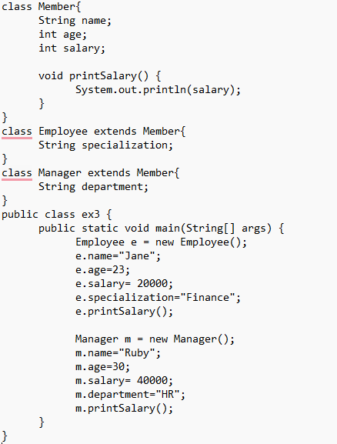
Solution 2

Slide 27
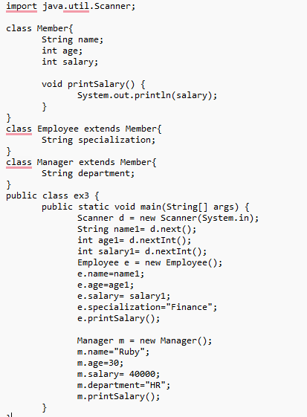
Solution 2 – By User Defined inputs

